Slide 1

Trees
Session 3

Slide 2
Agenda
Introduction
Binary Trees
Binary Tree Traversal
Linked Representation
Vector Representation
Summary

Slide 3
Introduction
Binary tree is a hierarchical data structure consisting of nodes, where each node contains a "left" pointer, a "right" pointer, and a data element.
The "root" pointer points to the topmost node in the tree.
The left and right pointers, called as children, recursively point to smaller "subtrees" on either side.
Examples of trees include:
Directory tree
Decision Tree
Family tree
Company organization chart
Table of contents, etc.

Slide 4

Tree Terminology
Root: node without parent (A)
Internal node: node with at least one child (A, B, C, F)
External node (a.k.a. leaf ): node without children (E, I, J, K, G, H, D)
Ancestors of a node: parent, grandparent, grand-grandparent, etc.
Depth of a node: number of ancestors
Height of a tree: maximum depth of any node (3)
Descendant of a node: child, grandchild, grand-grandchild, etc.
Subtree: tree consisting of a node and its descendants
A
subtree
B
C
D
E
F
G
H
I
J
K
BITS Pilani, Pilani Campus

Slide 5
Tree ADT
We use positions to abstract nodes
Generic methods:
integer size()
boolean isEmpty()
Iterator elements()
Iterator positions()
Accessor methods:
position root()
position parent(p)
positionIterator children(p)
Query methods:
boolean isInternal(p)
boolean isExternal(p)
boolean isRoot(p)
Update method:
object replace (p, o)
Additional update methods may be defined by data structures implementing the Tree ADT
BITS Pilani, Pilani Campus

Slide 6
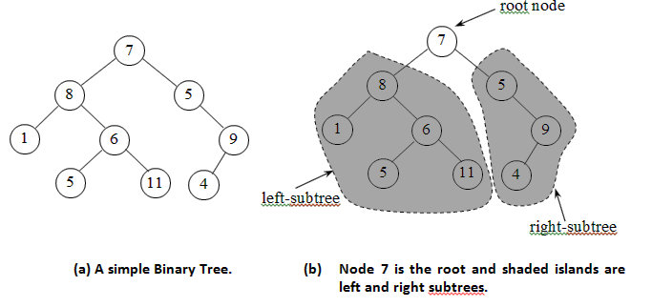
Binary Trees
A binary tree is a data structure in which each node has at most two children. Typically the child nodes are called left and right.

Slide 7
Definitions
General Tree
An ordered tree is formally defined as a finite set of one or more nodes such that
There is one especially designated node called the root of the tree, and
The remaining nodes are partitioned into n >= 0 disjoint sets T1, T2, …, Tn, and each of these sets in turn is a tree. The trees T1, T2, …, Tn are called the subtrees of the root

Slide 8
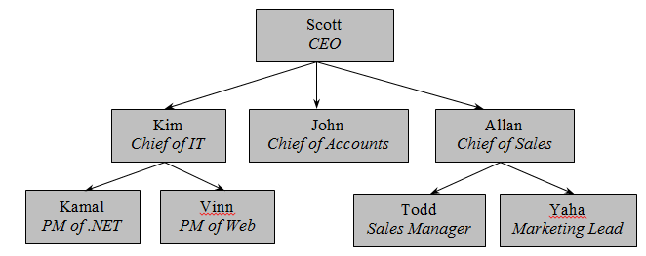
Example

Slide 9
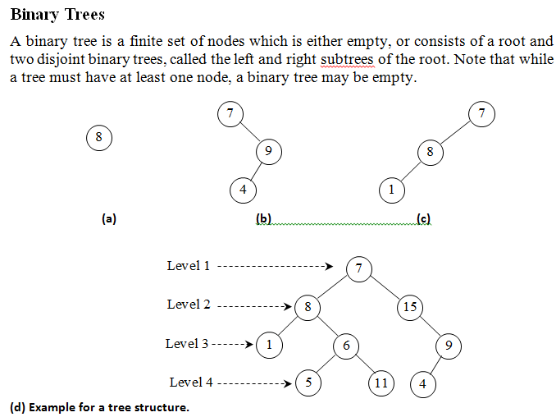
Binary Trees

Slide 10
Definitions
Children and Parent
Siblings
Left and Right descendent
Leaves
Level
Depth (or Height)
Degree
Rooted binary tree (every node at most two children)
Proper binary tree or Strict binary tree

Slide 11

Definitions…
A Complete binary tree
A complete binary tree is a full binary tree in which all leaves are at the same depth

Slide 12
Properties of Binary trees
The binary tree of n nodes has n-1 branches.
A binary tree of height h has at least h and at most 2^{h} – 1 nodes.
Level d has at most 2^{d} nodes.
A full binary tree of height h has (2^{h+1} – 1) nodes.
A binary tree with N internal nodes has N +1 external nodes.
A binary tree with N internal nodes has 2N edges or branches.
The maximum number of nodes of a binary tree of depth k is 2^{k} – 1.

Slide 13
Properties of Proper Binary Trees
Notation
n number of nodes
e number of external nodes
i number of internal nodes
h height
Properties:
e = i + 1
n = 2e − 1
h ≤ i
h ≤ (n − 1)/2
e ≤ 2^{h}
h ≥ log₂ e
h ≥ log₂ (n + 1) − 1
BITS Pilani, Pilani Campus

Slide 14
BinaryTree ADT
The BinaryTree ADT extends the Tree ADT, i.e., it inherits all the methods of the Tree ADT
Additional methods:
position left(p)
position right(p)
boolean hasLeft(p)
boolean hasRight(p)
Update methods may be defined by data structures implementing the BinaryTree ADT
BITS Pilani, Pilani Campus

Slide 15

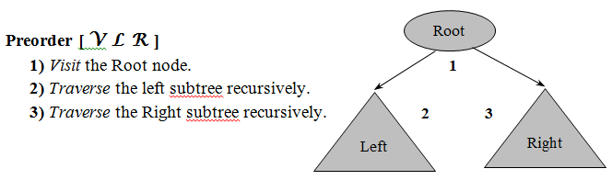
BINARY TREE TRAVERSAL

Slide 16
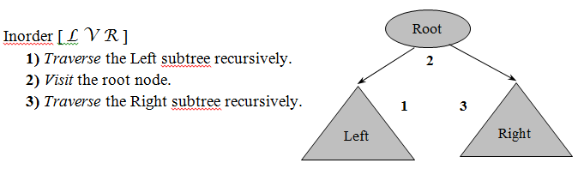
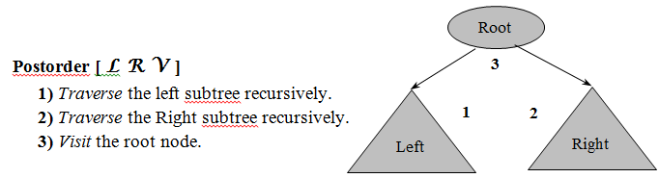
Traversals

Slide 17
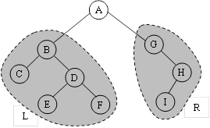
Examples
Preorder
A B C D E F G H I
Inorder
C B E D F A G I H
Postorder
C E F D B I H G A

Slide 18
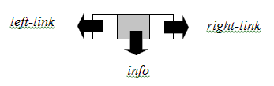
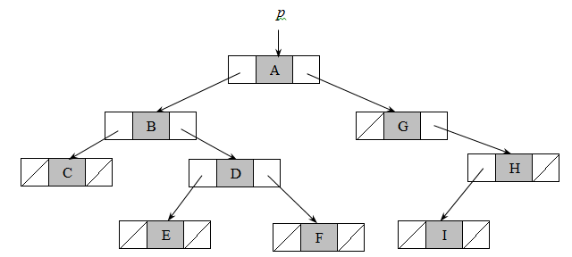
LINKED REPRESENTATION
There are two types of representations:
Array representation (implicit)
Linked representation (pointers)

Slide 19
C Declaration for Binary Tree
struct Tree
{
int info;
struct Tree *left;
struct Tree *right;
};
typedef struct Tree *TNODE;

Slide 20
Binary Tree Operations
Tree traversals (inorder, preorder, and postorder))
Creation of a binary tree given two traversals
Delete a tree node
Search a key in search tree
Compute the height
Compute the size
Compute the total number of leaf nodes
Copy a tree

Slide 21
Traversal - Algorithms
■ Algorithm Preorder(p)
// p – pointer to the root
if p ≠ NIL {
Write "Node visited: ", info(p)
Preorder(left(p))
Preorder(right(p))
}
end Preorder.

Slide 22
Inorder
■ Algorithm Inorder(p)
// p – pointer to the root
if p ≠ NIL {
Inorder(left(p))
Write "Node visited: ", info(p)
Inorder(right(p))
}
end Inorder.

Slide 23
Postorder
■ Algorithm Postorder(p)
// p – pointer to the root
if p ≠ NIL {
Postorder(left(p))
Postorder(right(p))
Write "Node visited: ", info(p)
}
end Postorder.

Slide 24
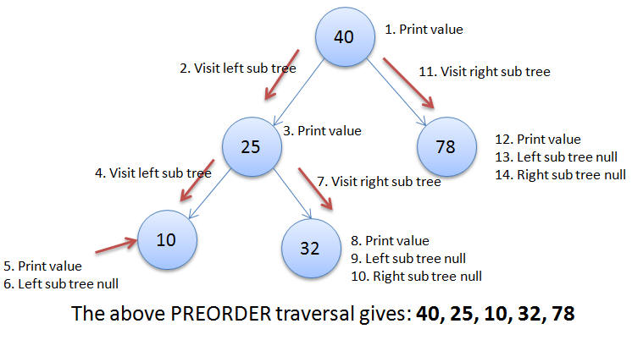
Preorder Traversal

Slide 25
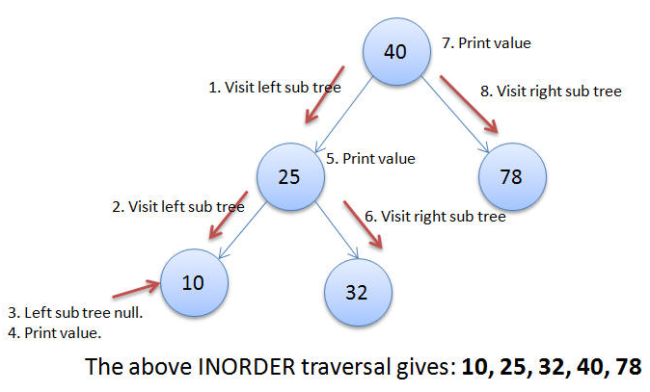
Inorder Traversal

Slide 26
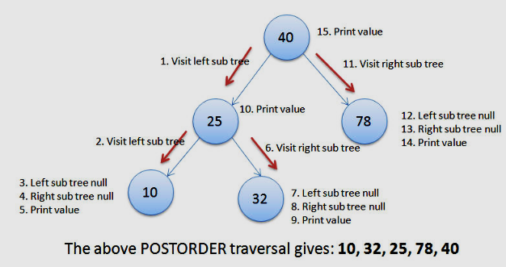
Postorder Traversal

Slide 27
Construction of Binary Tree
/* Function to create a new node */
Node* CreateNode(int data)
{
Node* newNode = new Node();
if (!newNode) {
cout << "Memory error\n";
return NULL;
}
newNode->data = data;
newNode->left = newNode->right = NULL;
return newNode;
}
struct Node {
int data;
Node* left;
Node* right;
};
1
2
3

Slide 28
Contd.
// Driver code
int main()
{/*
1
2 3
4
*/
Node* root = CreateNode(1);
Node* n2 = CreateNode(2);
Node* n3 = CreateNode(3);
root->left = n2;
root->right = n3;
cout << "Inorder traversal before insertion: ";
inorder(root);
cout << endl;
// Add new node right of node 3
Node* n4 = CreateNode(4);
n3->right = n4;
cout << "Inorder traversal after insertion: ";
inorder(root);
cout << endl;
return 0;
}
BITS Pilani, Pilani Campus

Slide 29
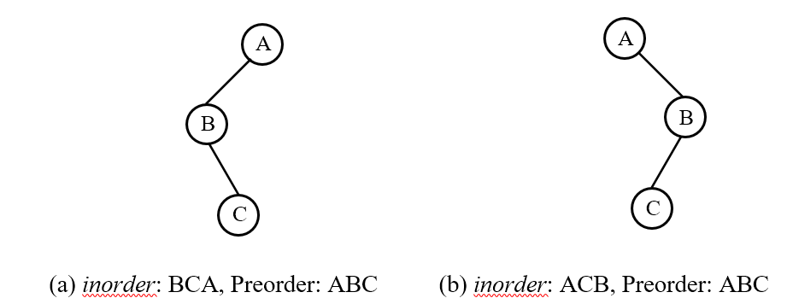
Construction of a Binary Tree using Preorder and Inorder Traverals
The first element in preorder sequence should be the root
The subsequent nodes are added to the binary tree picking them from the preorder sequence and noting the placement of nodes left or right) in the inorder sequence

Slide 30
Contd.
Step 1: Create the root as the first element from preorder.
Step 2: While there are still elements in preorder sequence do thru Step 5.
Step 3: Read the next node, x from preorder.
Step 4: Add x to the left of root, if it appears left of root in the inorder, else if it appears on right, then add x to the right of root.
Step 5: Checking of x is to be done recursively starting from the root up to the most recently added node.
Step 6: Return the tree.
Step 7: Stop.

Slide 31
Example
Inorder: B C E D F A G H
Preorder: A B C D E F G H
A
B
G
C
H
D
E
F

Slide 32
Vector Representation
If a node has an index i, its children are found at indices 2i+1 and 2i+2
Its parent (if any) is found at index floor((i-1)/2) (assuming the root has index zero).
This method benefits from more compact storage and better locality of reference, particularly during a preorder traversal.
However, it is expensive to grow and wastes space proportional to 2^{h} - n for a tree of height h with n nodes.

Slide 33
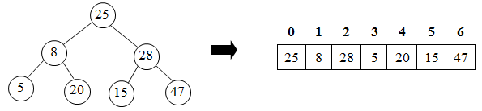
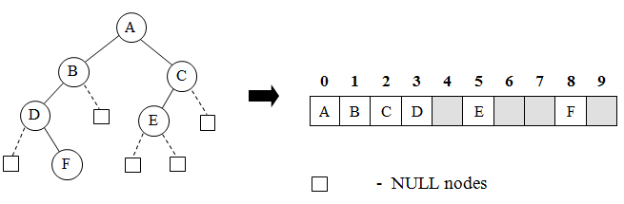
Representation
Non complete binary tree

Slide 34
Declaration
#define N 100
struct Implicit_Tree
{
int info;
int used;
};
(i) Creating Expression Tree from a Prefix Expression
(ii) Creating Expression Tree from a Postfix Expression

Slide 35
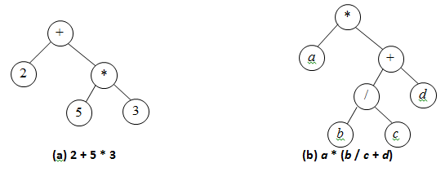
EVALUATION OF EXPRESSIONS

Slide 36
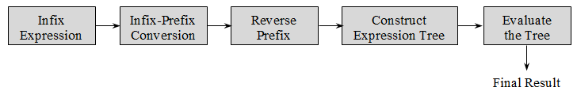
Method

Slide 37
Steps
1) Reverse the given prefix expression
2) Examine the next element in the input
3) If it is an operand then
Create a leaf node. i. e. node having no child
(left(node) = right(node) = NULL)
Copy the operand in data part
PUSH node's address on stack

Slide 38
Steps…
4) If it is an operator, then
(i) Create a node
(ii) Copy the operator in data part
(iii) POP address of node from stack and assign it to left(node)
(iv) POP address of node from stack and assign it to right(node)
(v) PUSH node's address on stack
5) If there is more input go to step 2
6) If there is no more input, POP the address from stack, which is the address of the root node of expression tree.

Slide 39
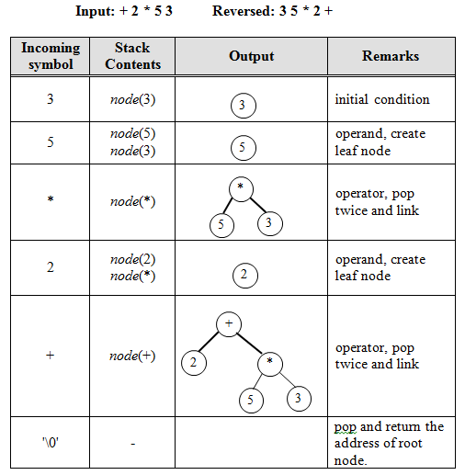
Example

Slide 40
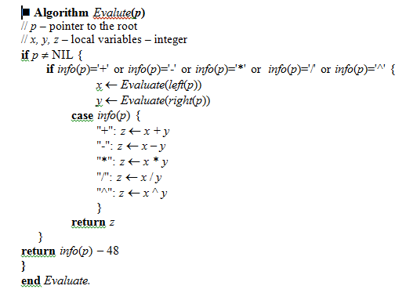
Algorithm

Slide 41
Summary

